Slide 1

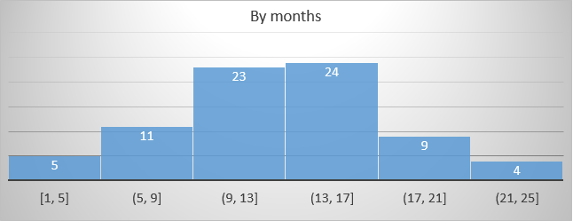
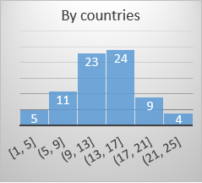
Orders Management System – Dashboard
Orders
Manage
Customers
Manage
Employees
Manage
Totals
Quantity
Money
Average
Max
Min
Totals
Products
Manage

Slide 2

Orders Management System - Orders
2 сентября 2018 г.
Orders management
Go to journal
Invoice view
Products at store
Products on order
Save
Is paid
Print
Id | Name | Price | On store | Select
21 | Jack's New England Clam Chowder | $12.34 | 123
Id | Name | Quantity
 | Total | $123.342
Invoice # 12/01/2018
12
Date: 10/01/2018
3
Customer: Vasilis Pumpkin
5
Employer: Nancy Davolio
12
12
Payment date: 12/01/2018
12
ID | Name | Q-ty | Price
 |  | Total

Slide 3
Orders Management System - Orders
2 сентября 2018 г.
Orders management
Go to creation
Invoice view
Invoices list
Is paid
Print
Id | Name | Price | On store | Select
21 | Jack's New England Clam Chowder | $12.34 | 123
Invoice # 12/01/2018
Date: 10/01/2018
Customer: Vasilis Pumpkin
Employer: Nancy Davolio
Payment date: 12/01/2018
ID | Name | Q-ty | Price
 |  | Total

Slide 4
Orders Management System - Customers
2 сентября 2018 г.
Customers management
Customers list
Add/Edit customer

Slide 5
Orders Management System - Products
2 сентября 2018 г.
Products management
Add new Product

Slide 6
Orders Management System - Employees
2 сентября 2018 г.
Employees management
Add new Employee

Slide 7


